Slide 1
Hilbert Huang Transform
Transform your data into frequency domain

Slide 2
Data Science Flow
Start!
1
Data Collection
Data Preprocessing
2
3
Feature Extraction, Transformation
Modeling
4
5
Testing
Evaluation
6
Result
Notes:
The EM algorithm application is Modelling step in the data science flow

Slide 3
Feature Extraction
Learned Previously:
Learned on This Session:
Histogram
Earth Movement Distance
K-Means Clustering
Kernel Mapping
GMM
HHT
PCA

Slide 4
What is HHT
way to decompose a signal into so-called intrinsic mode functions (IMF) along with a trend, and obtain instantaneous frequency data

Slide 5
INTRODUCTION
| Purpose
to transform the signal from time domain into the frequency domain
Because, we want to analyze the “vibration” pattern

Slide 6
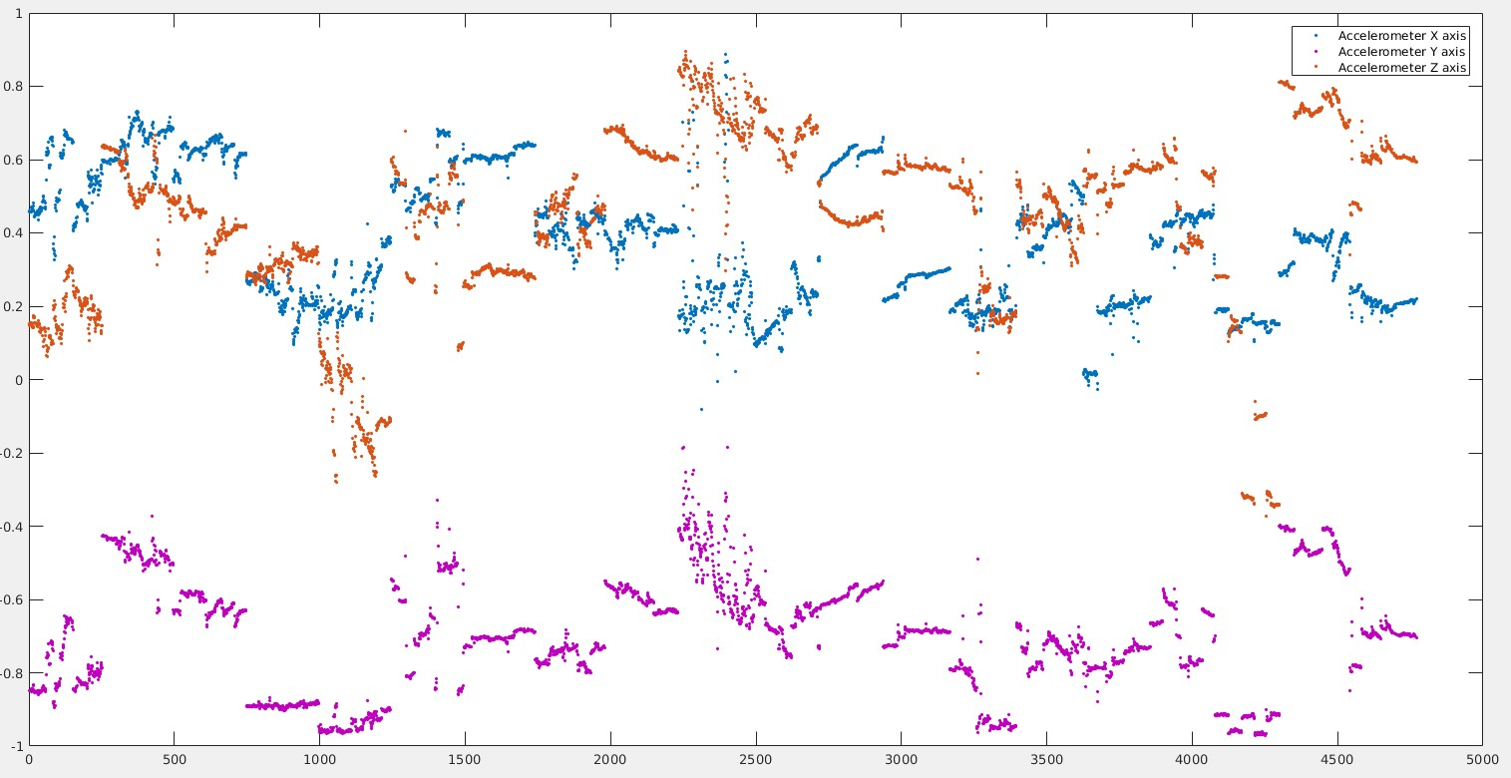
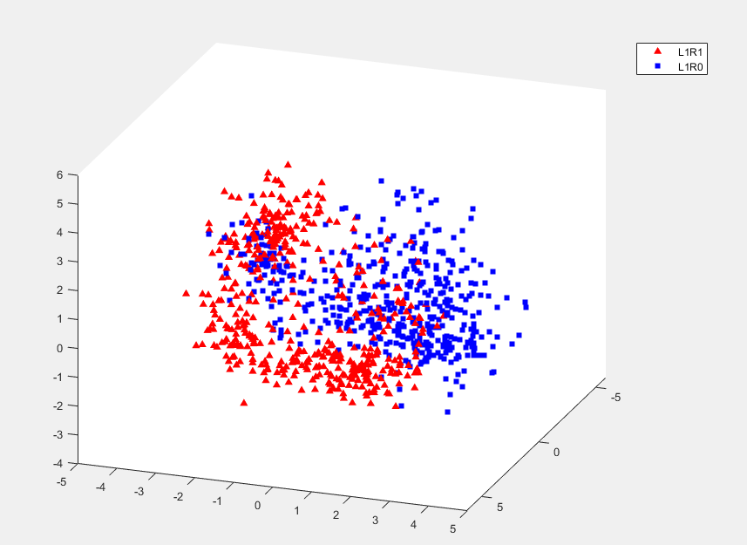
INTRODUCTION
| Why HHT?
Raw data: non-stationary non-linear
In 2 dimensions: Non-stationary raw signals
In 3 dimensons distribution : Non-linear signals

Slide 7
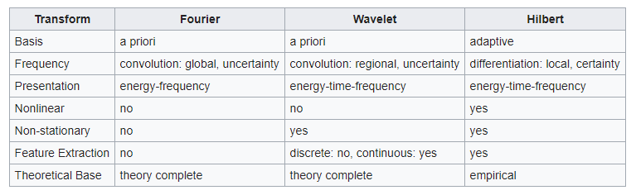
INTRODUCTION
| Why HHT?
because it is work well for data that is non-stationary and non-linear

Slide 8
Architecture
Raw Features
Split Training & Testing
Smartwatch raw signals
Accelerometer
Preprocessing
Partitioning time window = 2.5s
Training
Testing
Training Sample
Testing Sample
Feature Transformation
EMD
SVM Training
SVM Classification
HHT Spectrum
Model
Classification Result

Slide 9

HHT Implementation example (in driver recognition case)
L1R1
Left and Right hands on the steering wheel
Steering Wheel Handling
L0R1
Left out of the steering wheel, Right hand on the steering wheel
class
L1R0
Left hand on the steering wheel, Right hand out of steering wheel

Slide 10
| Step
Feature extraction
EMD
HHT Spectrum
Empirical mode decomposition (EMD)
Hilbert spectral analysis

Slide 11
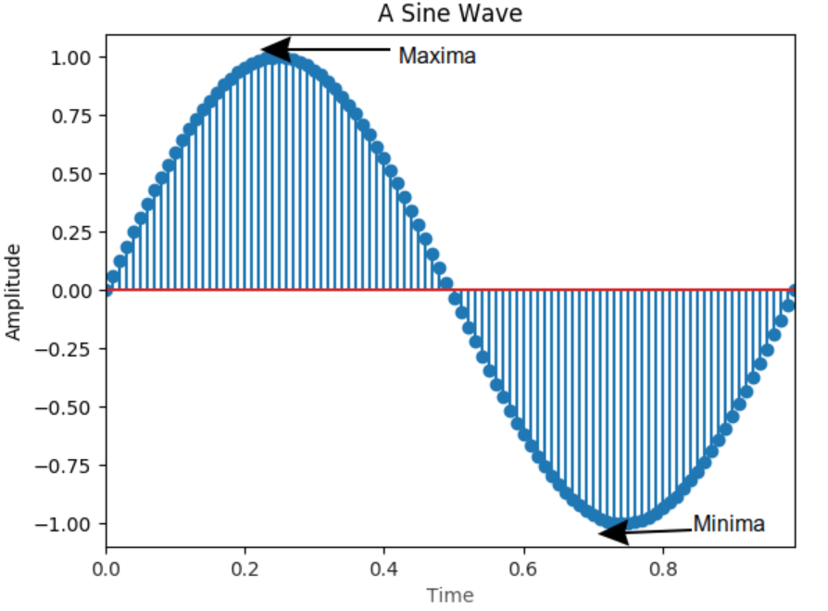
| Empirical mode decomposition (EMD)
Breaking down signals into various components, which called as intrinsic mode functions (IMF)
Raw Sample
To do the EMD step, previously we have to know about the local extreme value.
Local extreme is maxima and minima value. Maxima is a peak of wave and minima is a valley
EMD
IMF

Slide 12
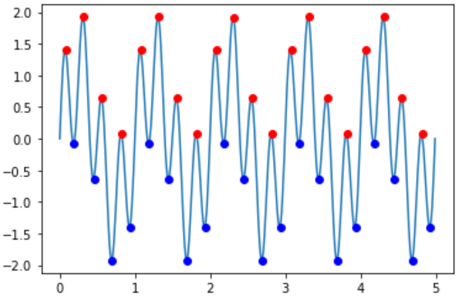
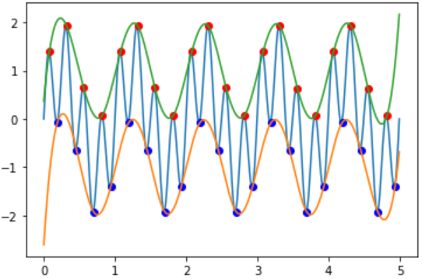
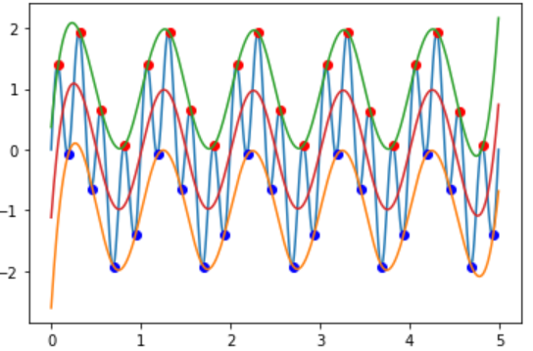
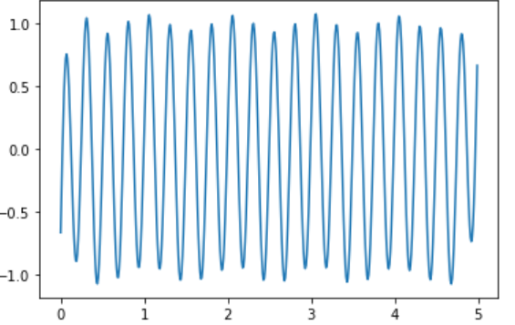
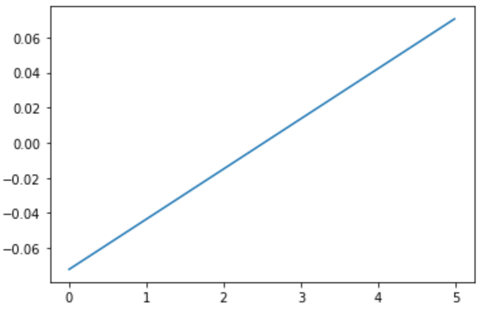
EMD Step
1
upper envelope
Identify all the local extrema in the test data
Create an envelope of minima and maxima from the array of minima and maxima.
(Connect all the local maxima by a cubic spline line as the upper envelope and Repeat the procedure for the local minima to produce the lower envelope)
Get the mean value, from the envelope of minima and maxima
Decrease the value of signal by the mean value of the envelope
Repeat all the procedure until M times
M = fix(log2(N))-1, where N is number of data
In the end we will have M number of IMF, also we will get M+1 data, which is called as residue
2
lower envelope
3
mean value
4
……..
5

Slide 13
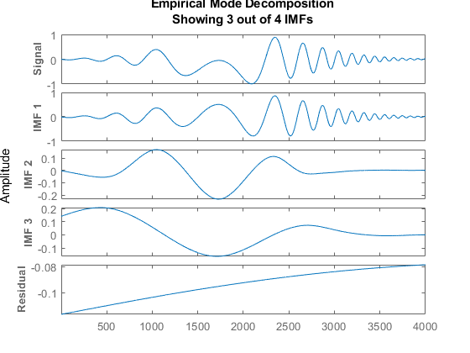
IMF

Slide 14
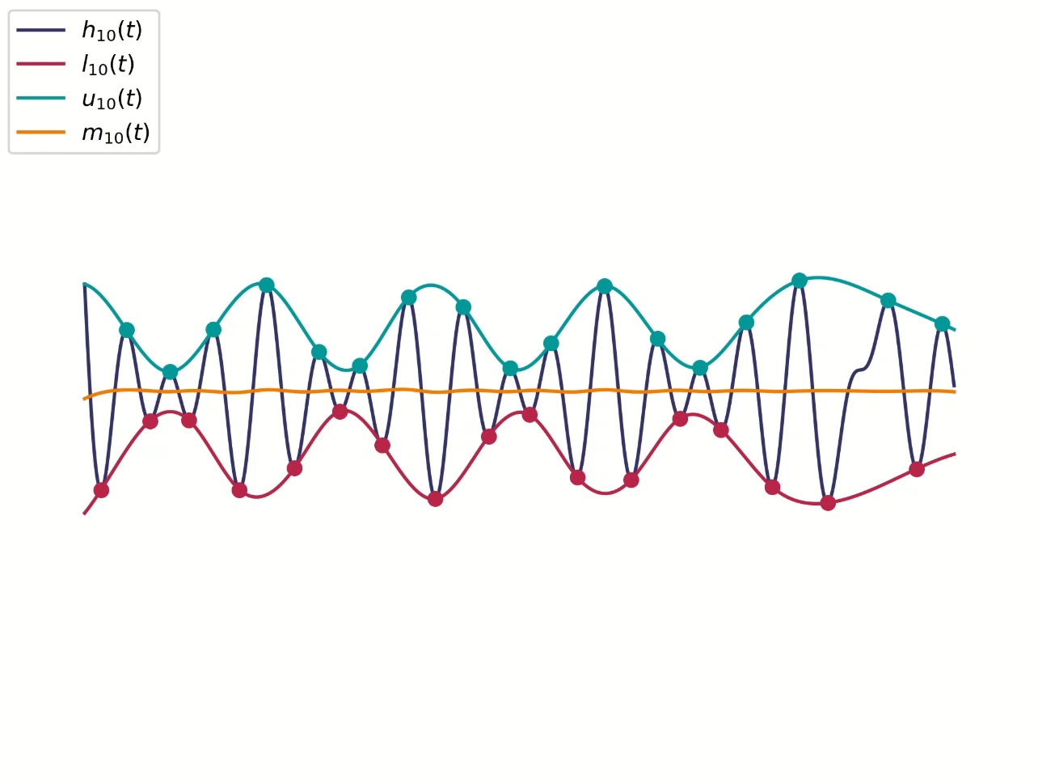
| Empirical mode decomposition (EMD) Ilustration
EMD illustration

Slide 15
| Hilbert spectral analysis
method for examining each IMF's instantaneous frequency as functions of time
IMF
Hilbert Transform
Get instantaneous amplitude,
(use hilbert.m matlab function)
Calculate inst frequency
Fs/(2*pi)*diff(unwrap(angle(z)))
Fs = frequency sample (50 Hz)
Pi = 3.14
Z = instantaneous amplitude
Spectrum extraction
HHT Spectrum

Slide 16
| HHT Spectrum
Inst Frequency
Inst Amplitude
Plotting spectrum
HHT Spectrum
After we get instantaneous frequency and instantaneous amplitude, we put them into spectrum block
Each block represent some range of frequency that we desired
Then, put each instantaneous amplitude into the right block, depends on its value of instantaneous frequency

Slide 17
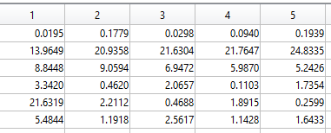
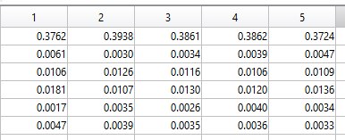
Frequency blocks
HHT Spectrum Step
get instantaneous amplitude (IA) and instantaneous frequency (IF)
We have frequency block that represent some range of frequency that we desired
put each instantaneous amplitude into the right block, depends on its value of instantaneous frequency, start from line 1,column 1 [1,1]
Ex 1: on [3,2]
IF=9.0594
On the freq block, we find that value in the range freq of block “9”
IA=0.0126
then put the IA on the side of the block
Ex 2: on [3,3]
0 < f ≤ 1
1
2
3
4
5
6
7
8
9
10
11
12
13
14
15
16
17
18
19
20
21
22
23
24
25
0.0126
1 < f ≤ 2
2 < f ≤ 3
3 < f ≤ 4
4 < f ≤ 5
5 < f ≤ 6
0.0116
6 < f ≤ 7
Instantaneous frequency
7 < f ≤ 8
8 < f ≤ 9
……
24 < f ≤ 25
Instantaneous amplitude
Range of freq

Slide 18
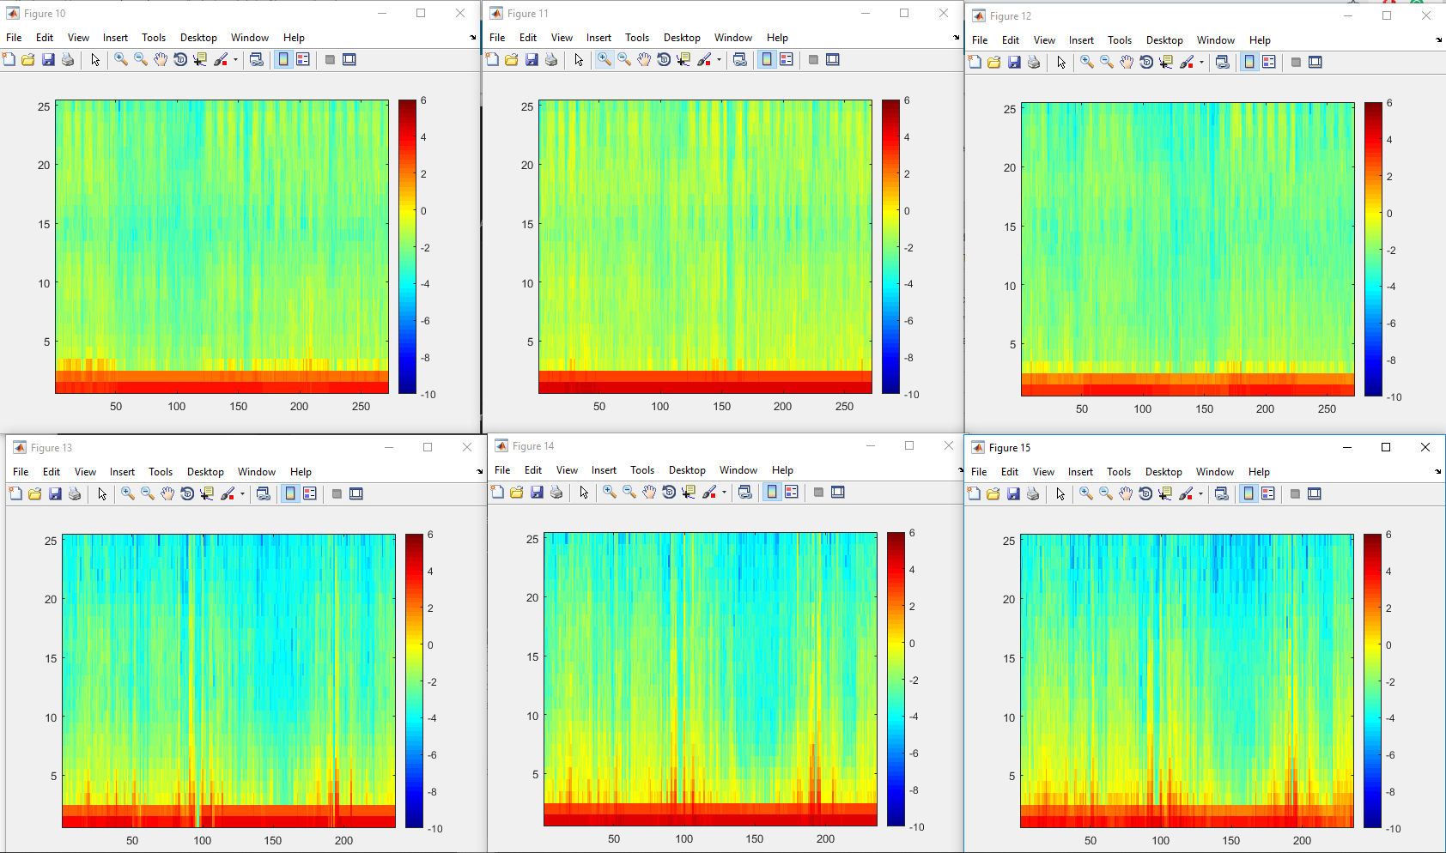
| Visualization of Raw Feature
Acc x
Acc y
Acc z
Inst. Amplitude color scale
L1R1
Both L1R1 and L1R0 show a strong intensity of the low frequency (1-2.5 Hz).
L1R1 have a stronger intensity on high frequency compared to L1R0.
We assume that the low frequency is the hand movement from the wheel, the high freq is the car engine vibrations
Frequency
L1R0
Data point in time order
Notes:
From the example: We can conclude that L1R1 indicate the low frequency better than L1R0.

Slide 19
Lab Session
Data
PPT Lab Session
Lab Session Exercise (word)
You can download on the ee-class

Slide 20
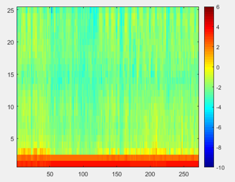
Conclusions
Hard to distinguish
Proper
method: Use HHT
Easier to distinguish → build a proper model (modeling)
Ex: for classification
a non stationary and non-linear data
Raw Signal versus HHT Signal
Notes:
It is hard to distinguish raw signals, expecially the non-stationary and non-linear signal
But it is easier to distinguish the HHT signal.
Since the signal is decomposed in time domain and the length of the IMFs is the same as the original signal, HHT preserves the characteristics of the varying frequency
We can distinguish classes well

Slide 21
LAB SESSION

Slide 22
Hilbert Huang Transform
Lab-Session

Slide 23
| What Students Have To Do in HHT Lab Session
Preparation
Complete The Code and Run it on the Matlab
Do the Task and submit the task requirement to the ee-class

Slide 24
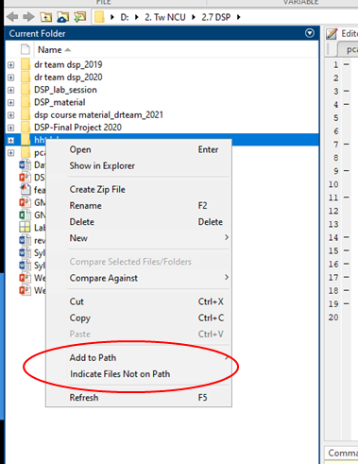
| A. PREPARATION
1. Tools:
Installed Matlab
2. Prepare the driver’s raw data & needed function:
Download the driver’s raw data (the data will be provided in ee-class)
Extract it into 1 folder
Copy the code of Lab Session word file into Matlab worksheet and save it into the same folder with the data
Add the folder to matlab path

Slide 25

| B. Complete The Code
HHT Lab Exercise flow
Load the mat file
Do EMD Process for L1R1 data
Do HHT Spectrum Process for L1R1 data
Do EMD Process for L1R0 data
Do HHT Spectrum Process for L1R0 data
Load mat File
L1R1 & L1R0
Visualization
For each sample of L1R1
Save result into .mat file
HHT Process
Purpose of the HHT exercise:
classify steering wheel handling
HHT Process
EMD
L1R1
Left hand on the wheel,
Right hand on the wheel
For each sample of L1R0
HHT Spectrum
HHT Process
L1R0
Left hand on the wheel,
Right hand out of the wheel

Slide 26
| B. Complete The Code
Load the mat file
Load the mat file (driver_data_L1R0.mat and driver_data_L1R1.mat on mat files folder)
Load(filename)

Slide 27

| B. Complete The Code
2. Do EMD Process for L1R1 data
Call function “hht_extraction”
The input are one partition (125 samples) of driver’s raw signal
Output are instantaneous frequency and instantaneous amplitude of the raw signals

Slide 28

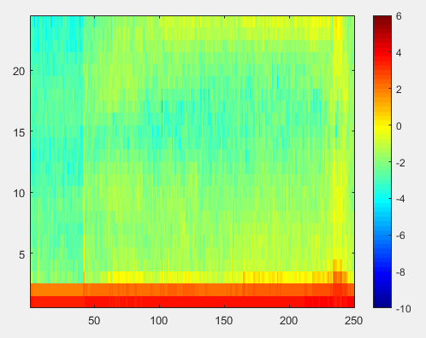
| B. Complete The Code
3. Do HHT Spectrum Process for L1R1 data
Call function called “spectrum_extraction”
The input are instantaneous frequency and instantaneous amplitude from hht_extraction function
The output of this function is 25 blocks of amplitude in every frequency range

Slide 29
| B. Complete The Code and Run it on the Matlab
4. Do EMD Process for L1R0 data
Same as [2], page 27
5. Do HHT Spectrum Process for L1R0 data
Same as [3], page 28

Slide 30
| C. Do the Task and send the task requirement to the ee-class
Compress(.zip,.rar) the following file with the name of the group (e.g. group_1.zip)
i. Code(*.m)
ii. Report(*.doc)
Result of HHT Spectrum (table and figure).
Conclusion of result (Conclusion of result: analyze the different of L1R1 and L1R0 HHT Spectrum and what is the beneficial of using HHT Spectrum).
To update the contents of report can be directly re-upload file with the name of version (e.g. Group_1_v2.zip)
Note：
Each group, one report
Upload the file before the deadline on ee-class(https://eeclass.ncu.edu.tw) to complete.

